Slide 1


Data-driven Storytelling Presentation:
Increasing our sales mix toward online retailer’s accounts will drive greater sales growth

Slide 2
Our product lines and marketing strategies
Among all account types, PRODUCT 1 is the main product line that our customers buy.
Among all marketing strategies, Catalog Inclusion is the common one.

Slide 3
The online retailer has the highest sale in product 1 in 2021

Slide 4
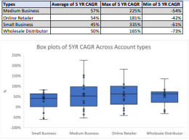
Shifting our sales mix will drive greater sales growth
While overall sales, the CAGR performance has been good, it could be better.
Closing some negative growth rates would free up sales and marketing resources
Over the last five years, the sales growth has shifted to the online retailer type.
Allocating more budget on marketing and freed-up sales resources to online retailers would drive the most sales growth

Slide 5
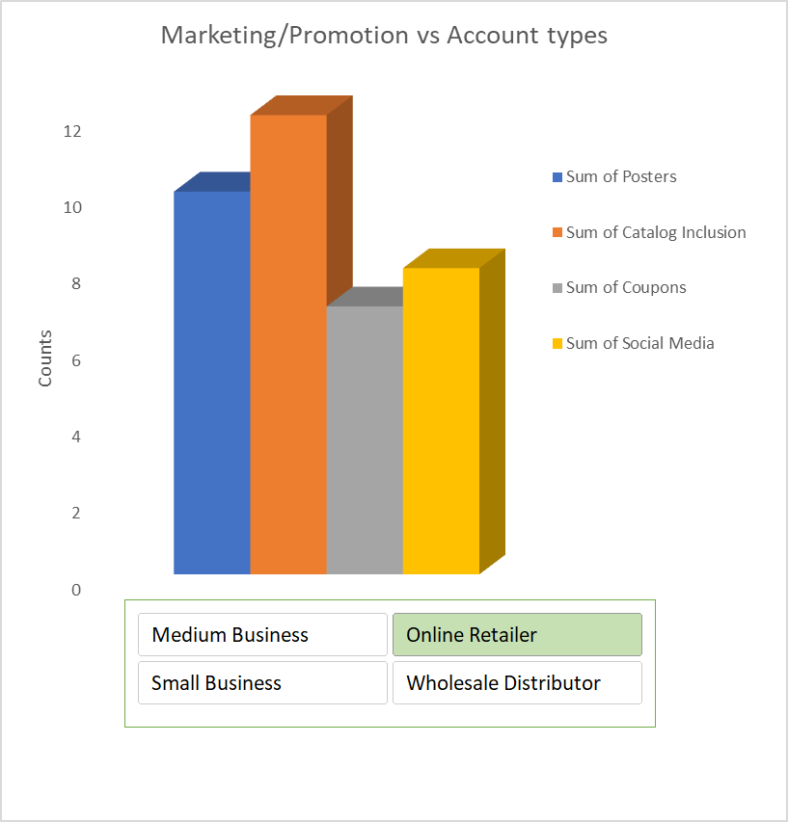
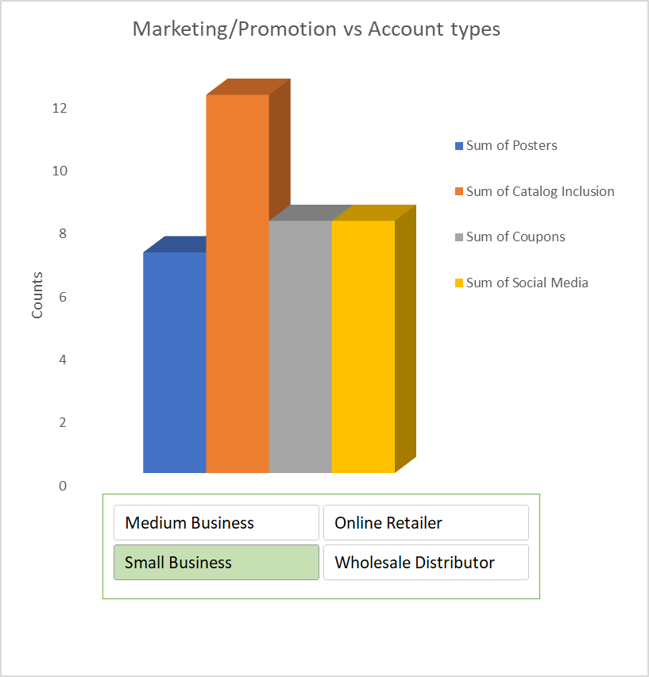
Summary
Increasing our marketing strategies for product 1 for online retailers.
Changing the marketing strategies for small businesses because it is not effective.
Closing these underperforming accounts immediately and launching an effort to identify the highest potential online retailer accounts for increased sales and marketing investment.

